Slide 1
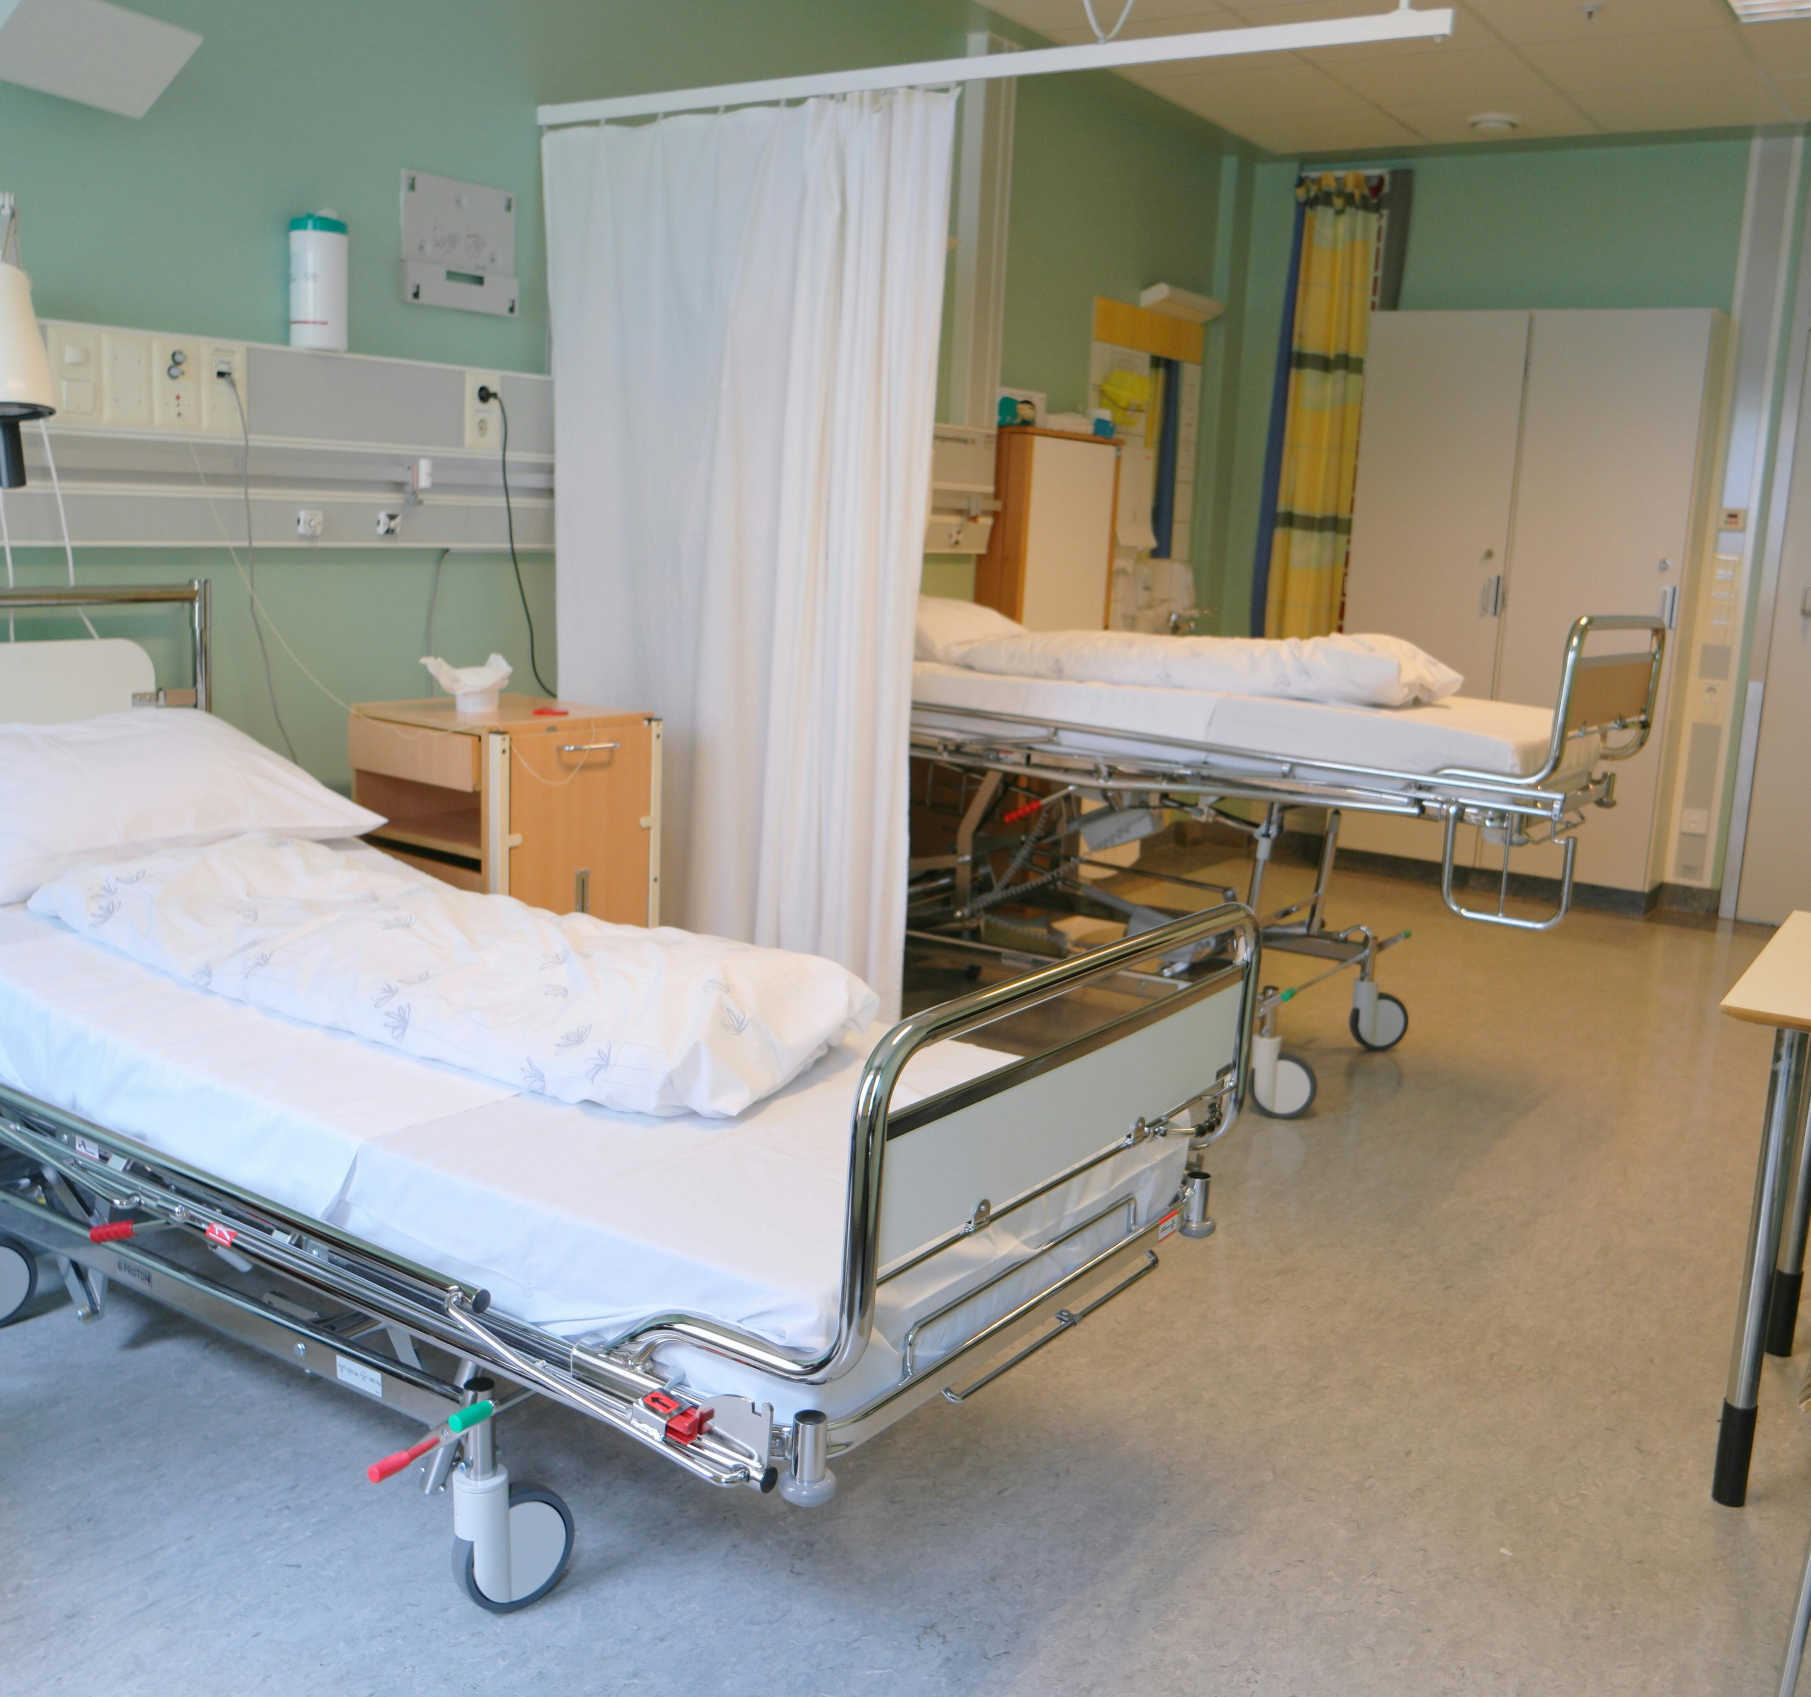
Predictive Classification model: the patient would require therapy or not?
Preetam Saha

Slide 2

Agenda
1.EDA
2.Approach
3. Accuracy and Efficacy of the model

Slide 3
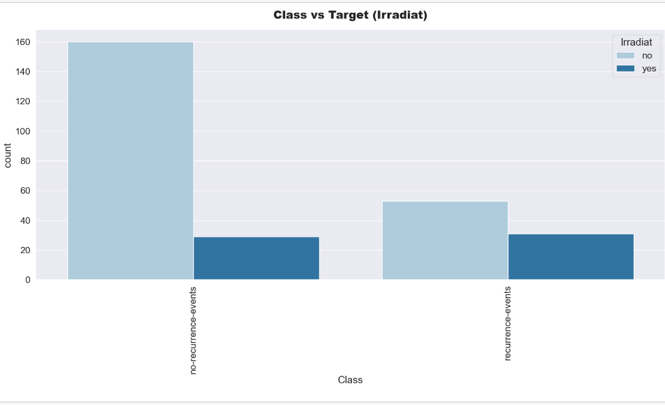
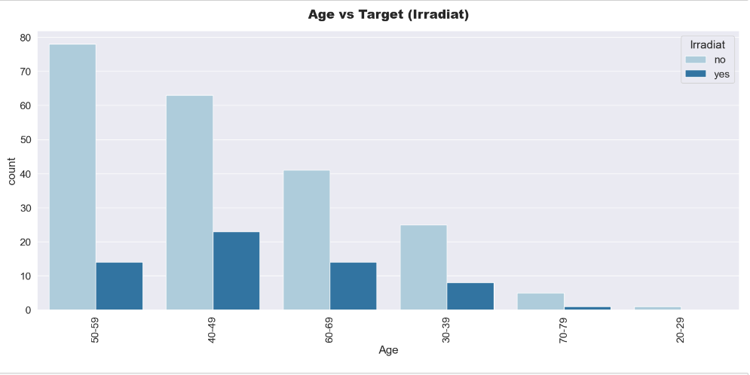
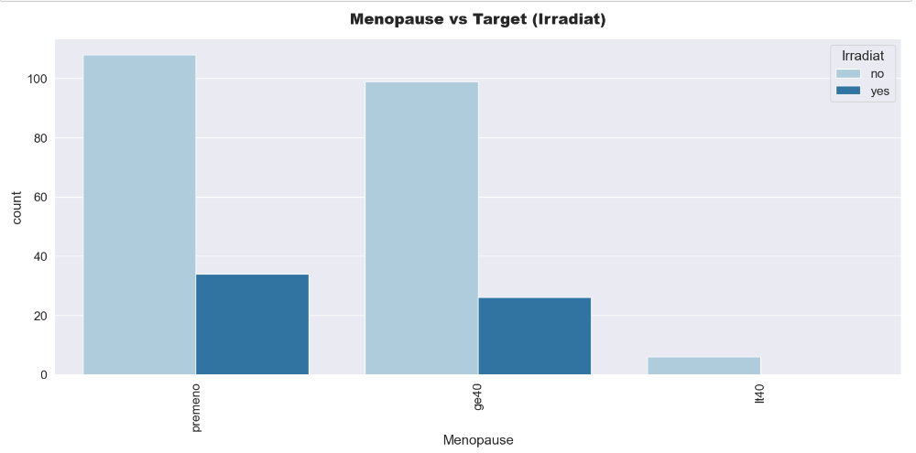
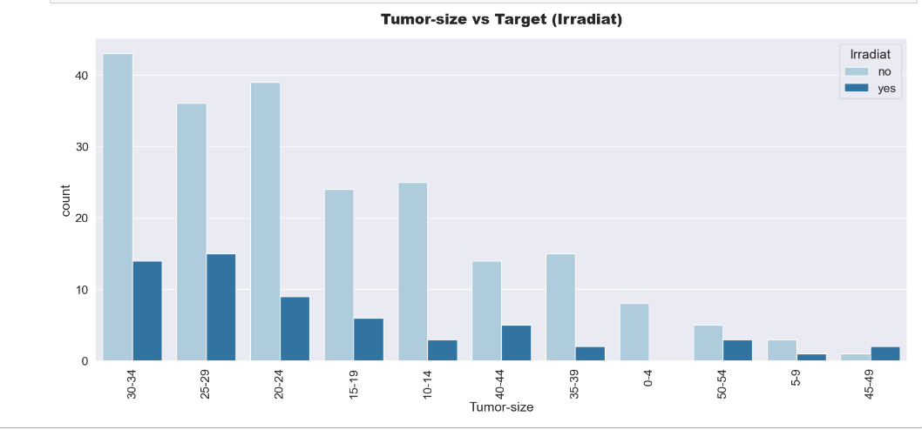
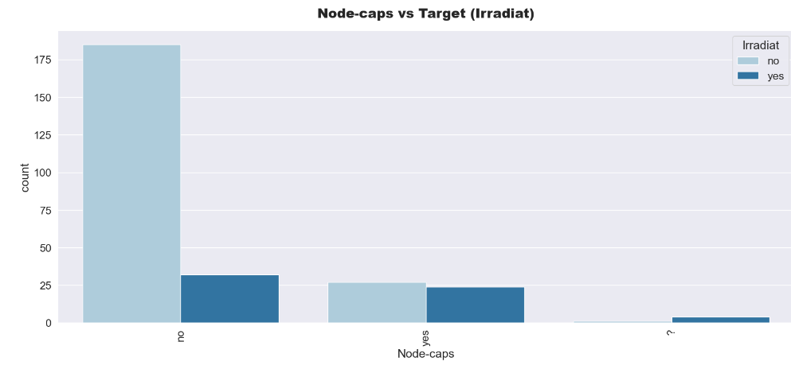
Eda-I

Slide 4
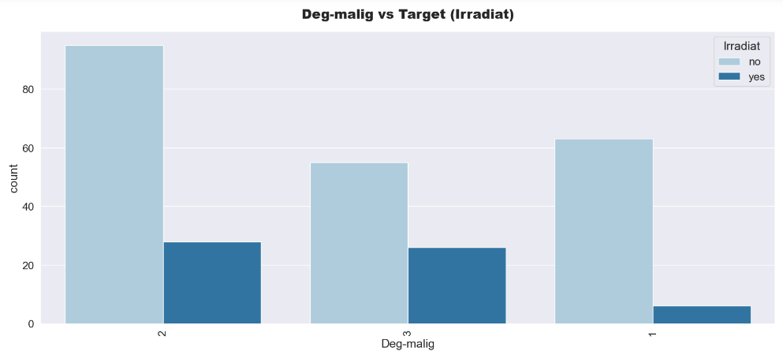
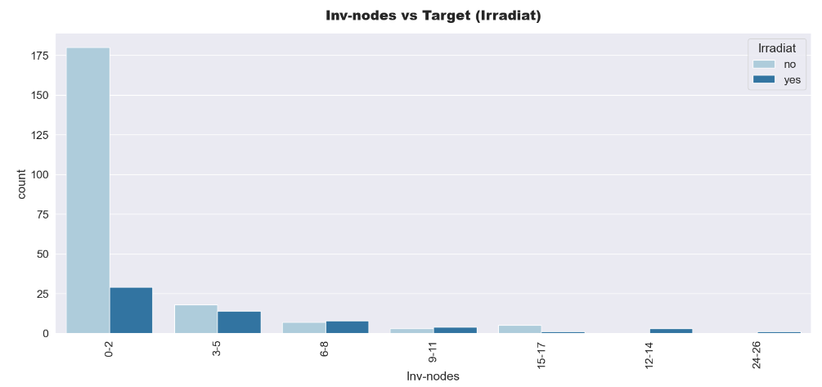
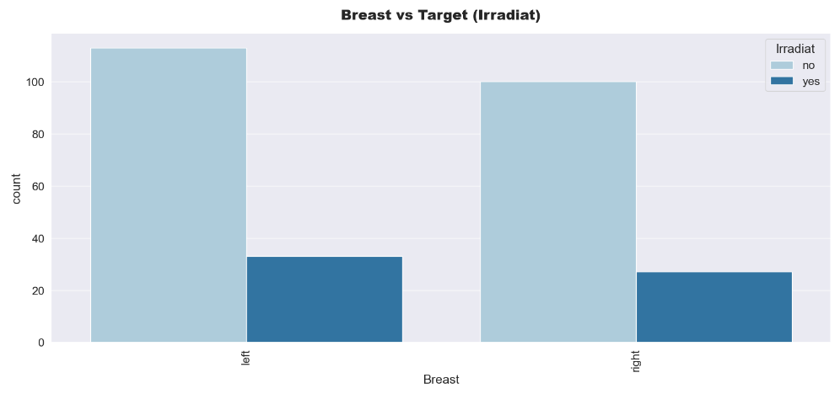
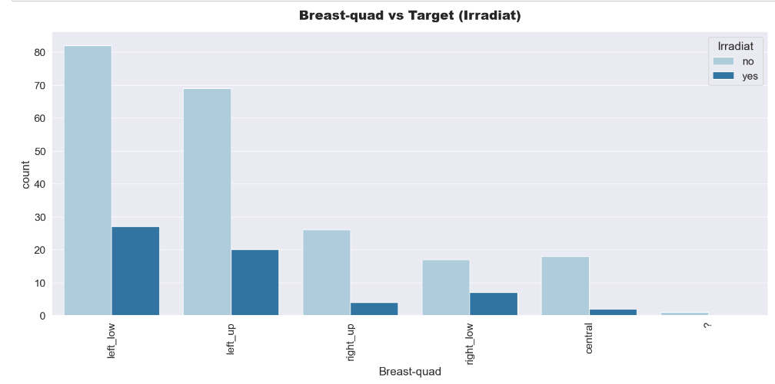
Eda-Ii

Slide 5
Approach
Data
1.Collected data
EDA
1. Checked distribution of target variable
Data Wrangling
1. Cleansed the data
Model Building & Evaluation
1. After splitting into Train and Val
Inference
1. Replaced the null values by its mode as per the training pipeline
2.Analyzed data
Like size of the data, no of missing values, outliers, no of features
(categorical and
Numerical)
2. Analyzed univariate and
Bivariate distribution of data
3. Made balanced target variable by using SMOTE
2. Encoded categorical features
(replaced ‘?’ by mode)
(70-30) different models were used
('Logistic_Regression','Decision_Tree','Random_Forest','Gradient_Boosting','XGB’ )
2.Evaluated on Val data( Random Forest best model)
3. Used its feature importance
2. Encoded the categorical features
as per the training pipeline
3. Predicted with
Probability score

Slide 6
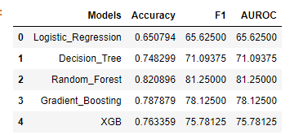
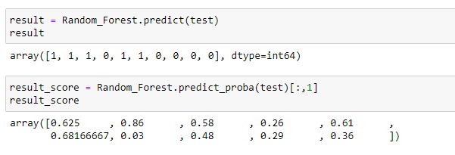
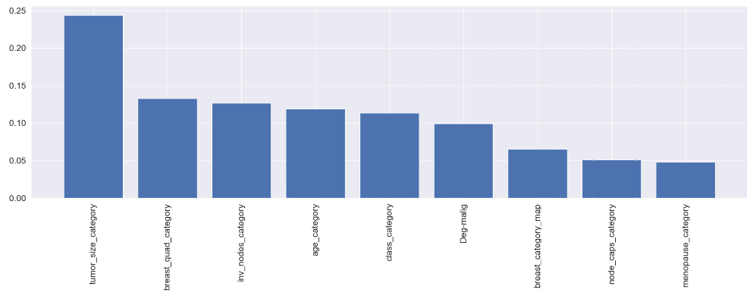
Summary
Model Comparison
Inference Score
Random Forest gave best accuracy, F1 score and AUCROC score
Top 3 Features for prediction are:
Tumor-size-category
Breast-quad-category
Inv-nodes category
​3. Predicted probabilities will help take decisions with more efficacies
Feature Importances

Slide 7
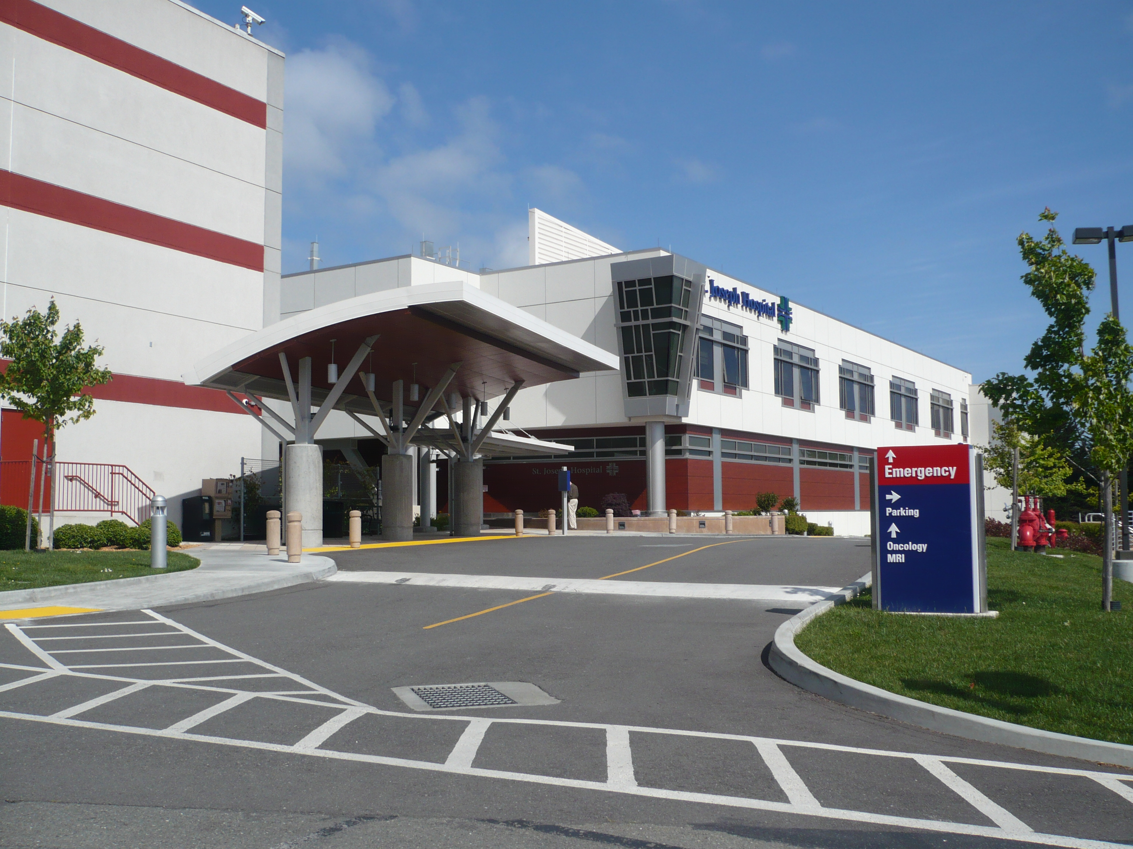
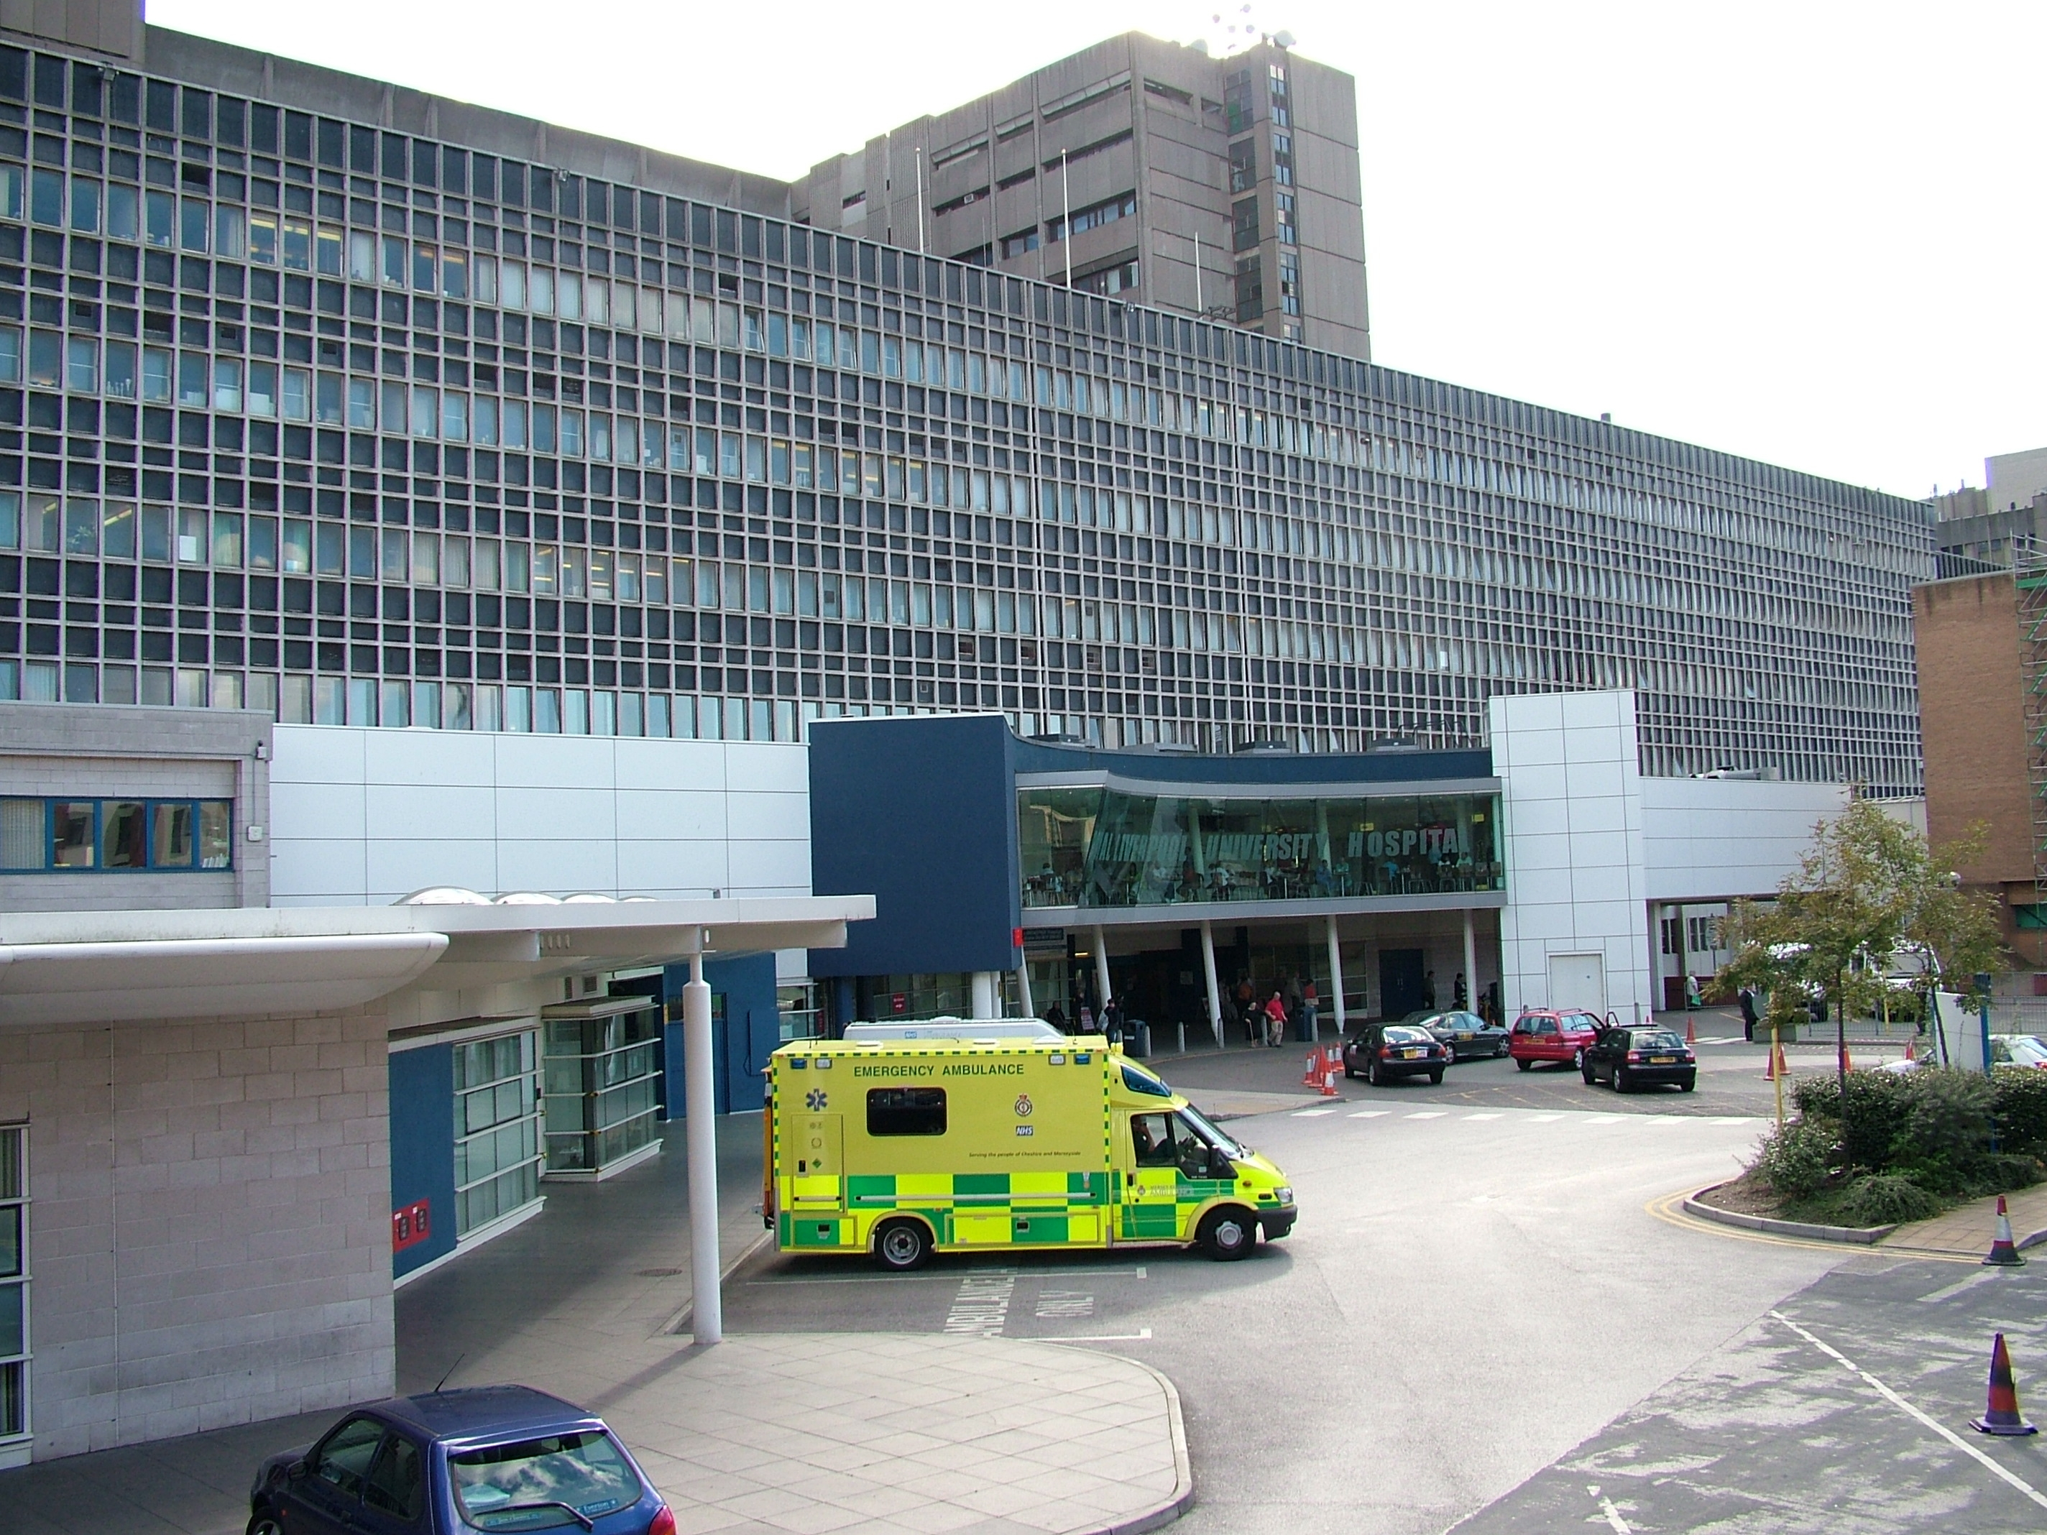
Thank you
Preetam Saha| preetam.jumech@gmail.com | +91 8250619941 | https://www.linkedin.com/in/preetam-saha-1985001a4/

